Slide 1
FEC Booklet FCE Reading

Slide 2
2
Part 1
You are going to read a newspaper article about sailing in single-handed boats known as ‘Oppies’.
Choose from the list A-I the sentence which best summarises each part (1-7) of the article. There is
one extra sentence which you do not need to use. There is an example at the beginning (0).
Mark your answers on the separate answer sheet.

Slide 3
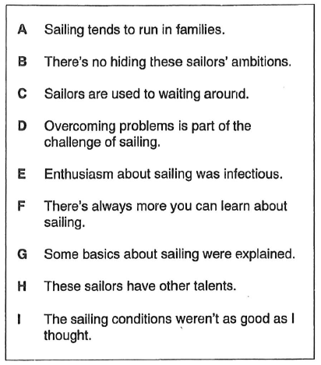
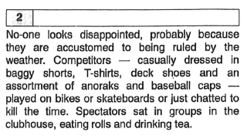
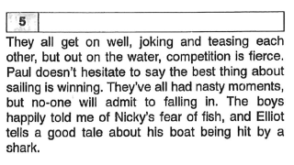
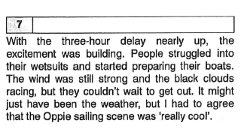
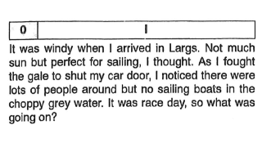
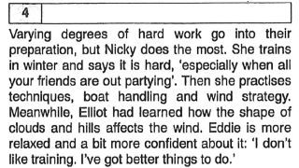
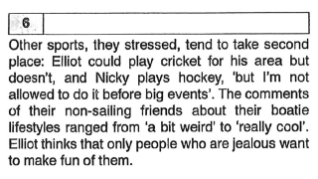
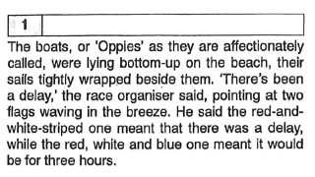
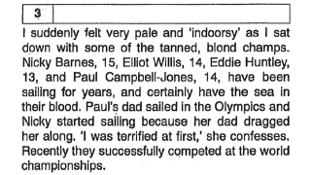
0I
1G
2C
3A
4F
5B
6H
7E

Slide 4
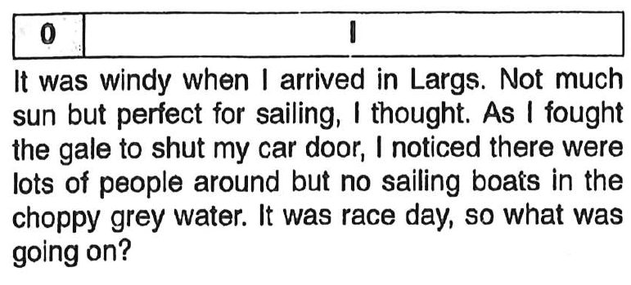

Slide 5
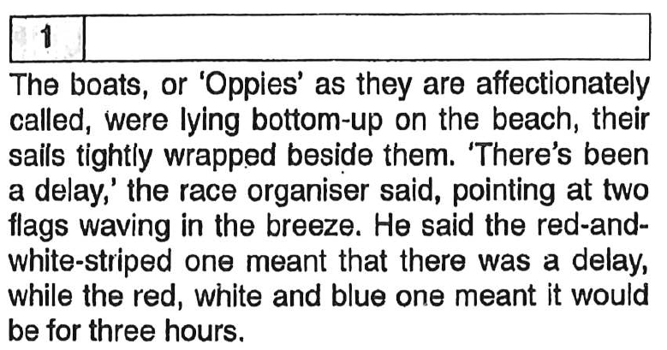

Slide 6
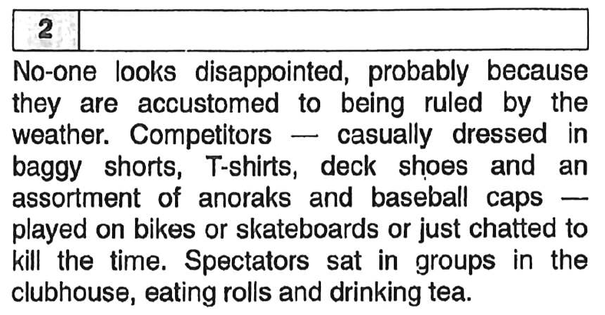

Slide 7
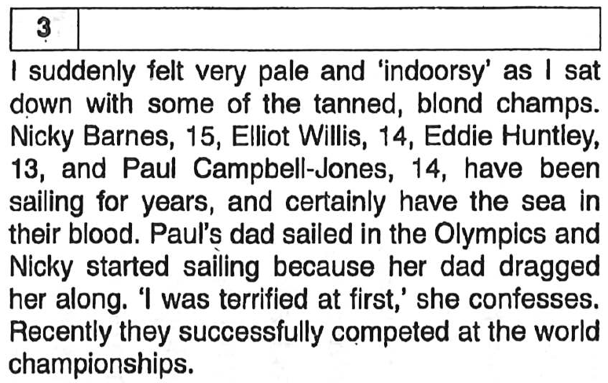

Slide 8
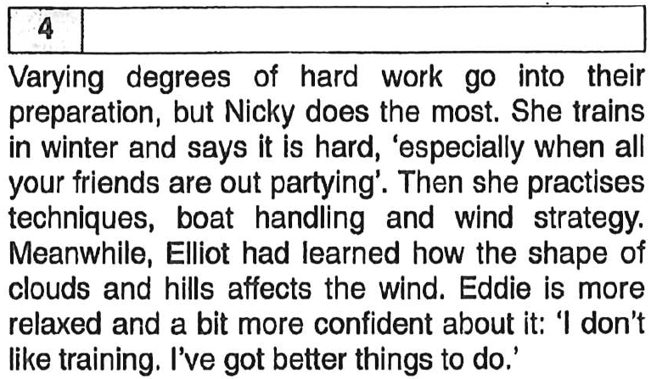

Slide 9
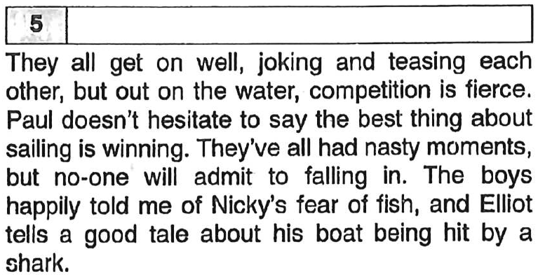

Slide 10
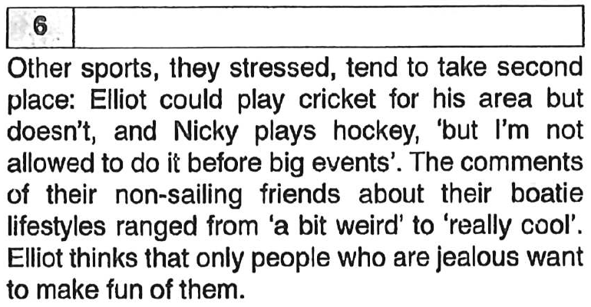

Slide 11
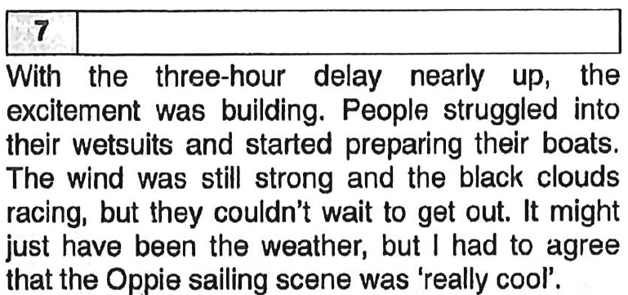

Slide 12
Part 2
You are going to read a magazine article about a radio presenter. For questions 8-14, choose the answer (A, B, C or D) which you think fits best according to the text.
Mark your answers on the separate answer sheet.

Slide 13

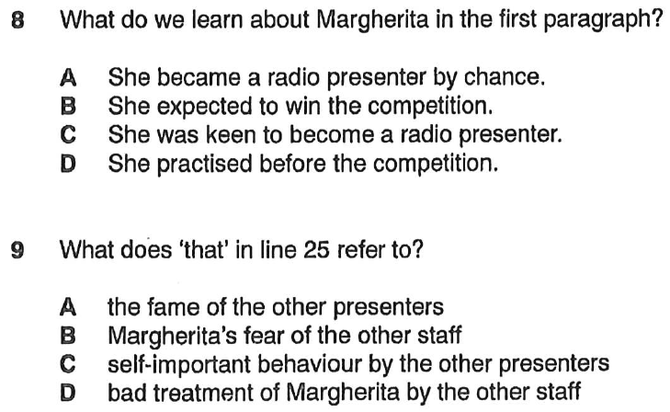
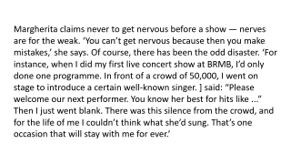
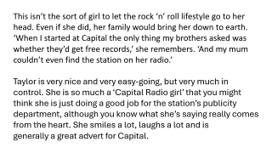
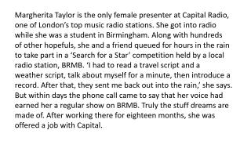
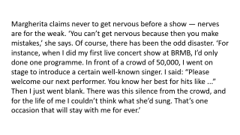
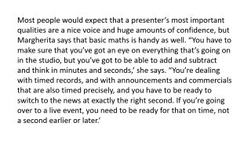
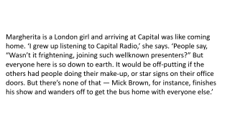
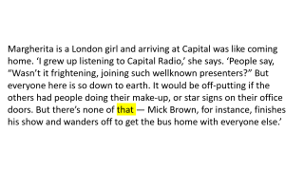
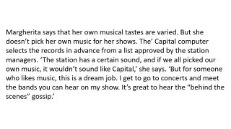
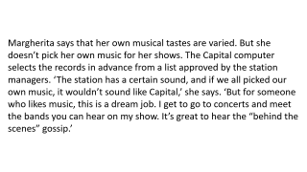
Part 2:

Slide 14
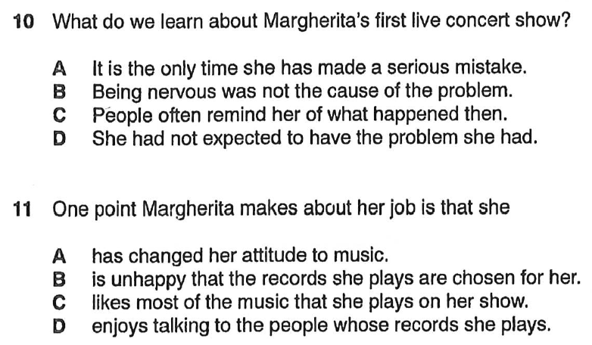
Part 2:

Slide 15
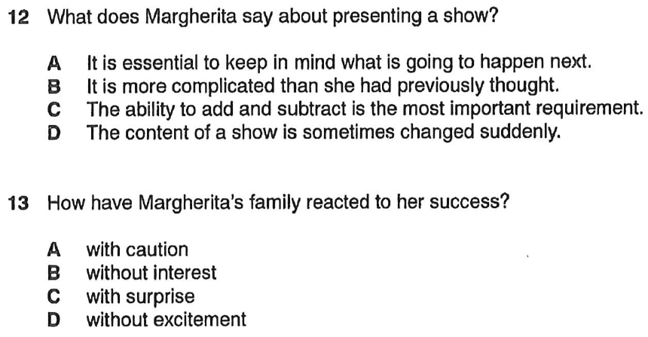
Part 2:

Slide 16
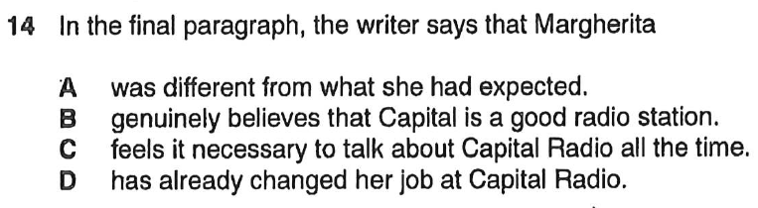

Slide 17
Margherita Taylor is the only female presenter at Capital Radio, one of London’s top music radio stations. She got into radio while she was a student in Birmingham. Along with hundreds
of other hopefuls, she and a friend queued for hours in the rain to take part in a ‘Search for a Star’ competition held by a local radio station, BRMB. ‘I had to read a travel script and a
weather script, talk about myself for a minute, then introduce a record. After that, they sent me back out into the rain,’ she says. But within days the phone call came to say that her voice had earned her a regular show on BRMB. Truly the stuff dreams are made of. After working there for eighteen months, she was offered a job with Capital.

Slide 18
Margherita is a London girl and arriving at Capital was like coming home. ‘I grew up listening to Capital Radio,’ she says. ‘People say, “Wasn’t it frightening, joining such wellknown presenters?” But everyone here is so down to earth. It would be off-putting if the others had people doing their make-up, or star signs on their office doors. But there’s none of that — Mick Brown, for instance, finishes his show and wanders off to get the bus home with everyone else.’

Slide 19
Margherita claims never to get nervous before a show — nerves are for the weak. ‘You can’t get nervous because then you make
mistakes,’ she says. Of course, there has been the odd disaster. ‘For instance, when I did my first live concert show at BRMB, I’d only done one programme. In front of a crowd of 50,000, I went on stage to introduce a certain well-known singer. I said: “Please welcome our next performer. You know her best for hits like ...”
Then I just went blank. There was this silence from the crowd, and for the life of me I couldn’t think what she’d sung. That’s one occasion that will stay with me for ever.’

Slide 20
Margherita says that her own musical tastes are varied. But she doesn’t pick her own music for her shows. The Capital computer
selects the records in advance from a list approved by the station managers. ‘The station has a certain sound, and if we all picked our
own music, it wouldn’t sound like Capital,’ she says. ‘But for someone who likes music, this is a dream job. I get to go to concerts and meet the bands you can hear on my show. It’s great to hear the “behind the scenes” gossip.’

Slide 21
Most people would expect that a presenter’s most important qualities are a nice voice and huge amounts of confidence, but
Margherita says that basic maths is handy as well. “You have to make sure that you’ve got an eye on everything that’s going on in the studio, but you’ve got to be able to add and subtract
and think in minutes and seconds,’ she says. “You’re dealing with timed records, and with announcements and commercials that are also timed precisely, and you have to be ready to
switch to the news at exactly the right second. If you’re going over to a live event, you need to be ready for that on time, not a second earlier or later.’

Slide 22
This isn’t the sort of girl to let the rock ‘n’ roll lifestyle go to her head. Even if she did, her family would bring her down to earth. ‘When I started at Capital the only thing my brothers asked was whether they’d get free records,’ she remembers. ‘And my mum couldn’t even find the station on her radio.’
Taylor is very nice and very easy-going, but very much in control. She is so much a ‘Capital Radio girl’ that you might
think she is just doing a good job for the station’s publicity department, although you know what she’s saying really comes from the heart. She smiles a lot, laughs a lot and is
generally a great advert for Capital.

Slide 23
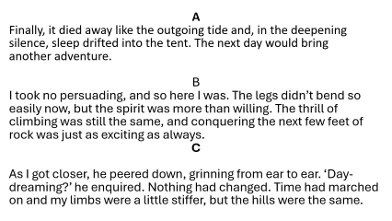
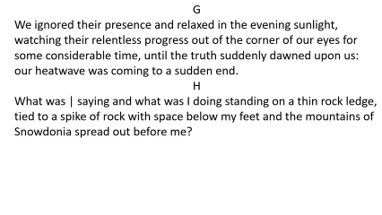
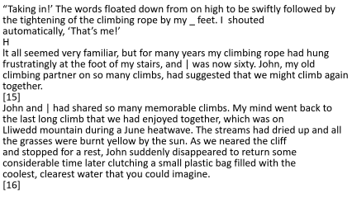
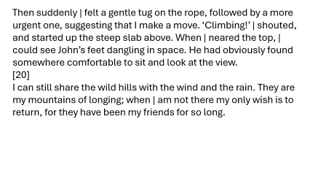
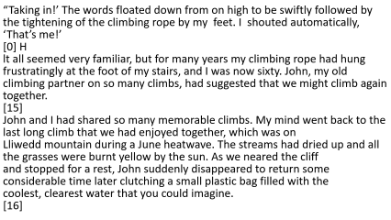
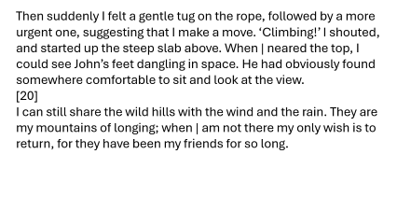
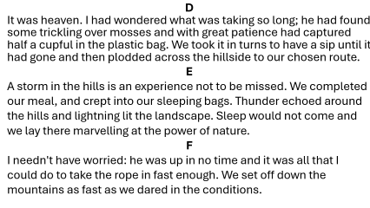
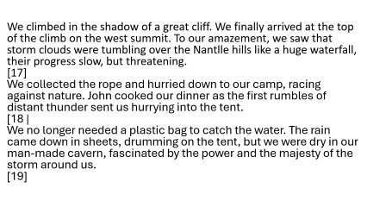
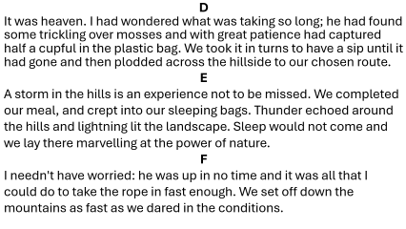

Part 3:
Welsh Mountains
0H
15B
16D
17G
18E
19A
20C

Slide 24
“Taking in!’ The words floated down from on high to be swiftly followed by the tightening of the climbing rope by my feet. I shouted automatically, ‘That’s me!’
[0] H
lt all seemed very familiar, but for many years my climbing rope had hung frustratingly at the foot of my stairs, and I was now sixty. John, my old climbing partner on so many climbs, had suggested that we might climb again together.
[15]
John and I had shared so many memorable climbs. My mind went back to the last long climb that we had enjoyed together, which was on
Lliwedd mountain during a June heatwave. The streams had dried up and all the grasses were burnt yellow by the sun. As we neared the cliff
and stopped for a rest, John suddenly disappeared to return some considerable time later clutching a small plastic bag filled with the
coolest, clearest water that you could imagine.
[16]

Slide 25
We climbed in the shadow of a great cliff. We finally arrived at the top of the climb on the west summit. To our amazement, we saw that storm clouds were tumbling over the Nantile hills like a huge waterfall, their progress slow, but threatening.
[17]
We collected the rope and hurried down to our camp, racing against nature. John cooked our dinner as the first rumbles of distant thunder sent us hurrying into the tent.
[18]
We no longer needed a plastic bag to catch the water. The rain came down in sheets, drumming on the tent, but we were dry in our man-made cavern, fascinated by the power and the majesty of the storm around us.
[19]

Slide 26
Then suddenly I felt a gentle tug on the rope, followed by a more urgent one, suggesting that I make a move. ‘Climbing!’ I shouted, and started up the steep slab above. When | neared the top, I could see John’s feet dangling in space. He had obviously found somewhere comfortable to sit and look at the view.
[20]
I can still share the wild hills with the wind and the rain. They are my mountains of longing; when | am not there my only wish is to return, for they have been my friends for so long.

Slide 27
A
Finally, it died away like the outgoing tide and, in the deepening silence, sleep drifted into the tent. The next day would bring
another adventure.
B
I took no persuading, and so here I was. The legs didn’t bend so easily now, but the spirit was more than willing. The thrill of climbing was still the same, and conquering the next few feet of rock was just as exciting as always.
C
As I got closer, he peered down, grinning from ear to ear. ‘Day-dreaming?’ he enquired. Nothing had changed. Time had marched on and my limbs were a little stiffer, but the hills were the same.

Slide 28
D
It was heaven. I had wondered what was taking so long; he had found some trickling over mosses and with great patience had captured half a cupful in the plastic bag. We took it in turns to have a sip until it had gone and then plodded across the hillside to our chosen route.
E
A storm in the hills is an experience not to be missed. We completed our meal, and crept into our sleeping bags. Thunder echoed around the hills and lightning lit the landscape. Sleep would not come and we lay there marvelling at the power of nature.
F
I needn't have worried: he was up in no time and it was all that I could do to take the rope in fast enough. We set off down the
mountains as fast as we dared in the conditions.

Slide 29
G
We ignored their presence and relaxed in the evening sunlight, watching their relentless progress out of the corner of our eyes for some considerable time, until the truth suddenly dawned upon us: our heatwave was coming to a sudden end.
H
What was | saying and what was I doing standing on a thin rock ledge, tied to a spike of rock with space below my feet and the mountains of Snowdonia spread out before me?

Slide 30
Part 4
You are going to read a newspaper article in which people talk about where they played as children.
For questions 21-26, choose from the people (A-G), and for questions 27-35, choose which person’s
play area (A-G) is referred to. The people and play areas may be chosen more than once. When more
than one answer is required, these may be given in any order. There is an example at the beginning (0).
Mark your answers on the separate answer sheet.

Slide 31
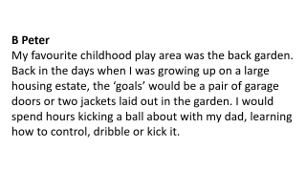
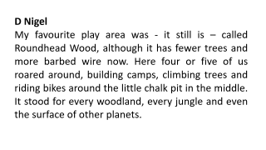
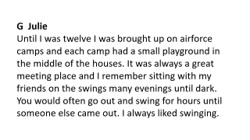
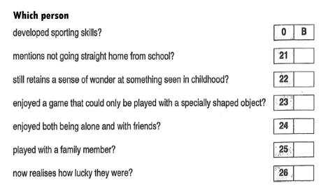
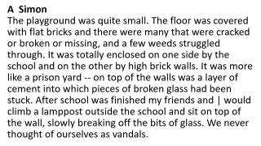
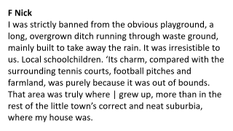
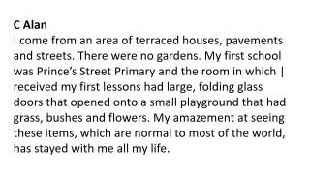
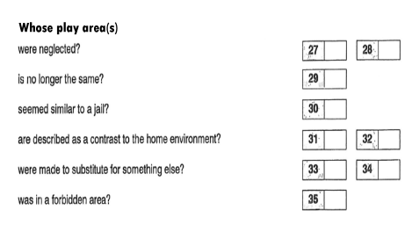
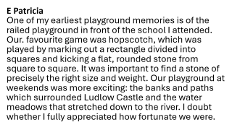
21A 22C 24G 25B 26E 27A/F 28A/F 28A/F
29D 30D 31C/F 32C/F 33C/F 34B/D 35F

Slide 32
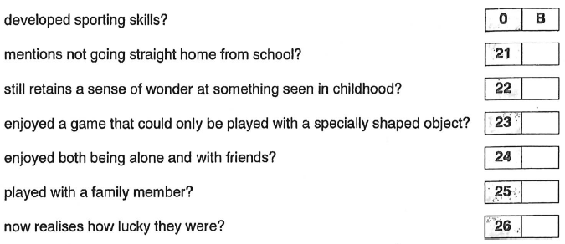
Which person

Slide 33
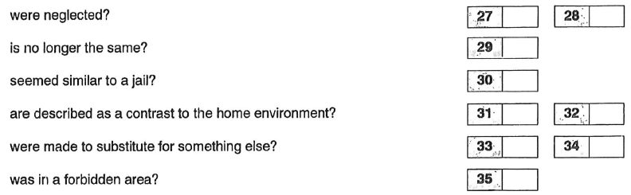
Whose play area(s)

Slide 34
A Simon
The playground was quite small. The floor was covered with flat bricks and there were many that were cracked or broken or missing, and a few weeds struggled through. It was totally enclosed on one side by the school and on the other by high brick walls. It was more like a prison yard -- on top of the walls was a layer of cement into which pieces of broken glass had been stuck. After school was finished my friends and | would climb a lamppost outside the school and sit on top of the wall, slowly breaking off the bits of glass. We never thought of ourselves as vandals.

Slide 35
B Peter
My favourite childhood play area was the back garden. Back in the days when I was growing up on a large housing estate, the ‘goals’ would be a pair of garage doors or two jackets laid out in the garden. I would spend hours kicking a ball about with my dad, learning how to control, dribble or kick it.

Slide 36
C Alan
I come from an area of terraced houses, pavements and streets. There were no gardens. My first school was Prince’s Street Primary and the room in which | received my first lessons had large, folding glass
doors that opened onto a small playground that had grass, bushes and flowers. My amazement at seeing these items, which are normal to most of the world, has stayed with me all my life.

Slide 37
D Nigel
My favourite play area was - it still is – called Roundhead Wood, although it has fewer trees and more barbed wire now. Here four or five of us roared around, building camps, climbing trees and riding bikes around the little chalk pit in the middle. It stood for every woodland, every jungle and even the surface of other planets.

Slide 38
E Patricia
One of my earliest playground memories is of the railed playground in front of the school I attended. Our. favourite game was hopscotch, which was played by marking out a rectangle divided into squares and kicking a flat, rounded stone from square to square. It was important to find a stone of precisely the right size and weight. Our playground at weekends was more exciting: the banks and paths which surrounded Ludlow Castle and the water meadows that stretched down to the river. I doubt whether I fully appreciated how fortunate we were.

Slide 39
F Nick
I was strictly banned from the obvious playground, a long, overgrown ditch running through waste ground, mainly built to take away the rain. It was irresistible to us. Local schoolchildren. ‘Its charm, compared with the surrounding tennis courts, football pitches and farmland, was purely because it was out of bounds. That area was truly where | grew up, more than in the rest of the little town’s correct and neat suburbia, where my house was.

Slide 40
G Julie
Until I was twelve I was brought up on airforce camps and each camp had a small playground in the middle of the houses. It was always a great meeting place and I remember sitting with my friends on the swings many evenings until dark. You would often go out and swing for hours until someone else came out. I always liked swinging.

